Slide 1
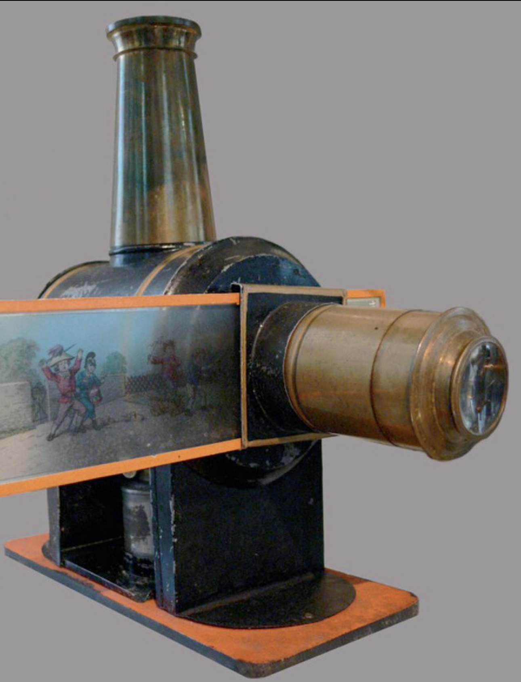
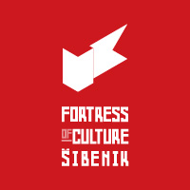
DIGITAL TECHNOLOGIES AND HERITAGE VALORIZATION: IS METAVERSE „THE NEXT BIG THING?”
Project FORTIC conference & EFFORTS Annual Congress: “Sustainable business models for fortifications”
St. John’s Fortress Campus, ŠIBENIK
October 24th -25th 2024

Slide 2
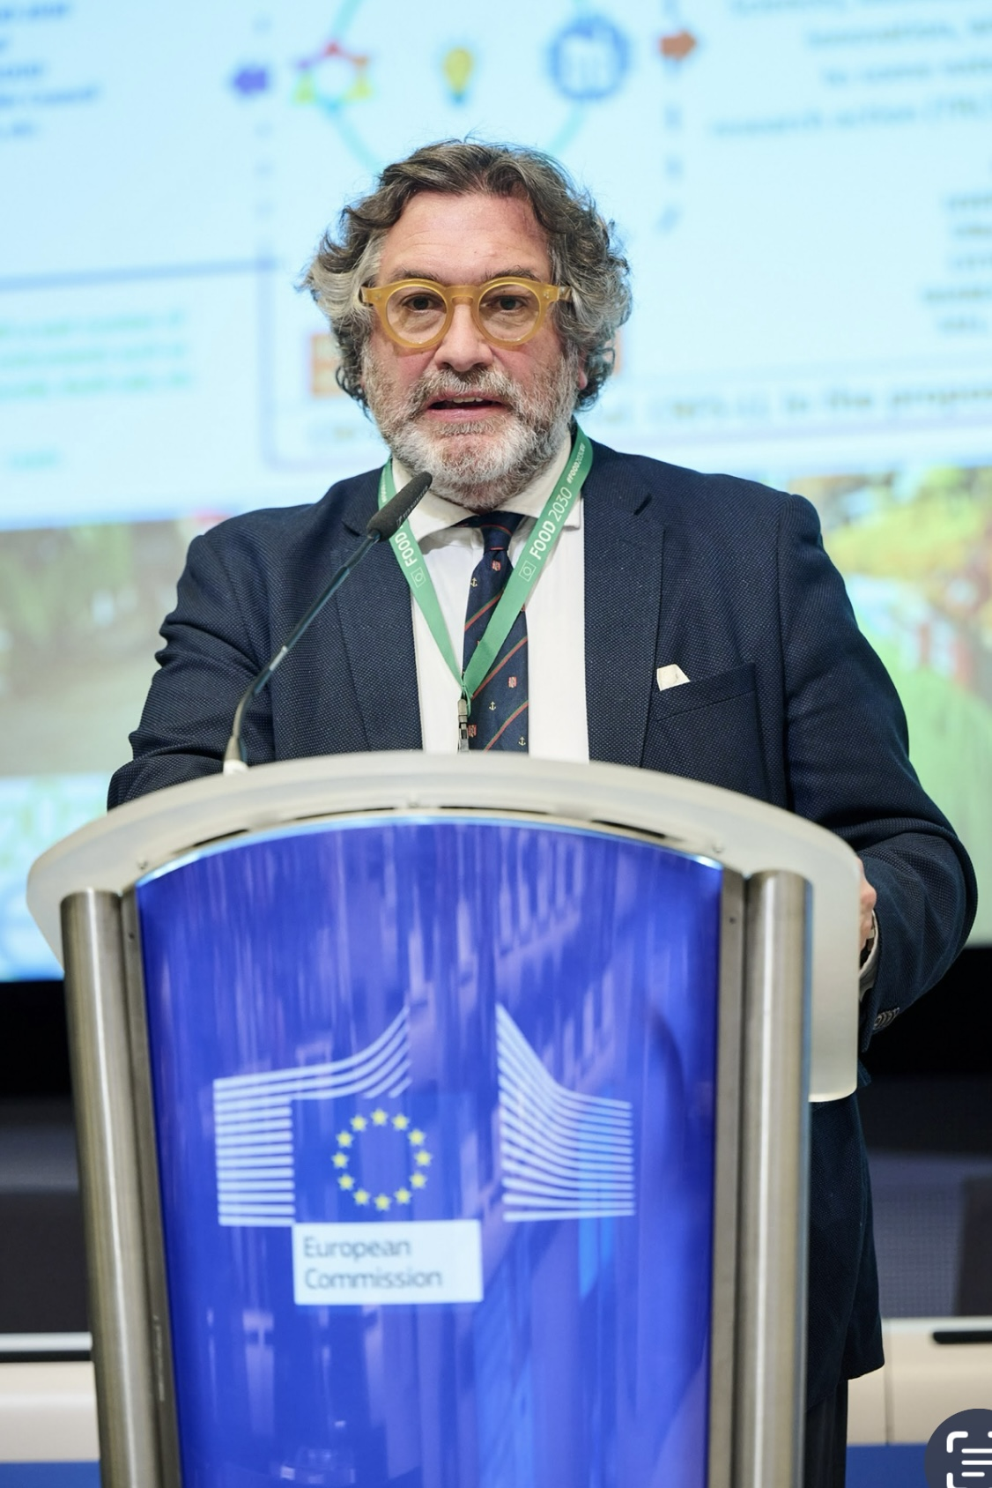
Daniele Sferra – Ca Foscari University of Venice –
Department of Economics
Expert in international relations, cultural cooperation, fortified heritage, and sustainable tourism;
has worked on over 35 EU projects.
He served in 30 missions globally for UN, OSCE and EU as election expert.
Since 2015, he's been a project officer/manager at Ca' Foscari University in Venice and since 2019, adviser for international relations for Fondazione Forte Marghera.
He is currently Vice-President of EFFORTS and FORTIC project manager for Ca’ Foscari University of Venice – Department of Economics.
*

Slide 3
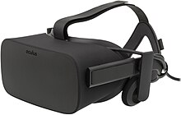
IS METAVERSE A BIG THING? - YES
IT DEMOCRATISE ACCESS TO CULTURAL HERITAGE ▷ FOSTERS WIDER UNDERSTANDING AND PRESERVATION OF CULTURAL SITES;
IMMERSIVE TECHNOLOGIES (AR, MR, VR) OVERCOMES: 1) BARRIERS OF SPACE; 2) TIME; 3) SOCIO-ECONOMIC CONSTRAINTS ▷ INCLUSIVE PARTICIPATION IN CULTURAL DIALOGUE AND EDUCATION;
POWERFUL TOOLS FOR CULTURAL ENGAGEMENT AND PRESERVATION ▷ AI SUPPORTIVE GENERATIVE 360° CONTENT (HMDs – Head-Mounted Displays which are small displays or projection technology integrated into eyeglasses or mounted on a helmet or hat), haptic gloves.
The first VR successfully consumer market VR headset was the Oculus Rift in 2013 – primarily designed for gaming market, but also suitable for educational applications
The Mixed Reality (MR) Apple Vision Pro (June 2023) expand user base for the technology «spatial computing» (coined by MIT researcher Simon Greenwold in 2003 – range of technologies aimed at bridging the gap between the digital and physical realm

Slide 4
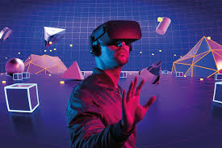
WHAT IS METAVERSE?
IT IS A COLLECTIVE VIRTUAL SPACE WHERE USERS CAN INTERACT WITH EACH OTHER AND DIGITAL ENVIRONMENTS IN REAL-TIME
IT UTILIZES IMMERSIVE TECHNOLOGIES LIKE AUGMENTED REALITY (AR) AND VIRTUAL REALITY (VR)
IT COMBINES PHYSICAL AND DIGITAL WORLD ENABLING PEOPLE TO SOCIALIZE, WORK, PLAY AND CREATE IMMERSIVE VIRTUAL ENVIRONMENTS
The term «metaverse» was first coined by Neal Stephenson in his 1992 science fiction novel «Snow Crash» . In the book, the Metaverse is a virtual reality-based successor to the Internet, where users can interact with each other and digital objects in a shared space
In 2011 with the launch of Google’s Art and Culture, enabled visits to museums, accessible to anyone with a smartphone or a computer
Last decade the use of complete Virtual Learning Environment (VLE) became widely available

Slide 5
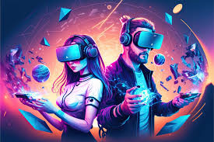
WHAT IS METAVERSE?
KEY FEATURES:
IMMERSIVE EXPERIENCES: USERS ENGAGE WITH 3D ENVIRONMENTS, OFTEN USING AVATARS;
SOCIAL INTERACTION: PEOPLE CAN MEET , CHAT AND COLLABORATE IN SHARED VIRTUAL SPACES
DIGITAL ECONOMY: USERS CAN PURCHASE, SELL AND TRADE VIRTUAL GOODS, INCLUDING NFTs (NOT FUNGIBLE TOKENS) AND VIRTUAL REAL ESTATE)
PERSISTENT: IT EXSIST CONTINOUSLY , EVEN WHEN USERS LOG OFF, UNLIKE TRADITIONAL VIDEO GAMES OR WEBSITES

Slide 6
WHAT IS METAVERSE?
3 KEY FACTORS OF DIGITAL EMBODIMENT OF USERS:
IMMERSION: ENHANCED BY USE OF HIGH-FIDELITY VISUAL PROCESSING, LOW LATENCY, REALISTIC SOUNDS, OLFACTORY STIMULATION (OVR) AND HAPTIC FEEDBACK WHICH MAKES VIRTUAL ENVIRONMENT MORE REALISTIC;
PRESENCE : ABILITY OF A USER TO FEEL PHISICALLY PRESENT IN A VIRTUAL LOCATION AND ENVIRONMENT – As opposed to immersion, which is associated with the technical aspects of the virtual system, presence considers the quality and nature of feeling
INTERACTIVITY: THE DEGREE TO WHICH USER CAN INTERACT AND INFLUENCE THE VIRTUAL ENVIRONMENT

Slide 7
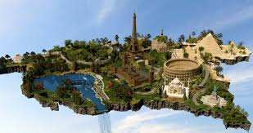
WHAT IS METAVERSE?
3 KEY FEATURES OF DIGITAL EMBODIMENT OF USERS IN THE ART AND CULTURE ECOSYSTEM:
LOCATION: THE PHYSICAL LOCATION WHERE THE CULTURAL SIE IS CURRENTLY LOCATED
PLACE : MOVES BEYOND GEOGRAPHYCAL LOCATION AND INSTEAD REFERS TO THE SYMBOLIC OR CULTURAL SIGNIFICANCE OF A LOCATION – „SENSE OF PLACE”
IDENTITY: THE WAYS IN WHICH THE INDIVIDUAL OR COLLECTIVE IDENTITY OF VIEWER IS REPRESENTED OR CONSTRUCTED IN A WORK OF ART SITE, THROUGH THE PROCESS OF VIEWING OR INTERACTING WITH IT

Slide 8
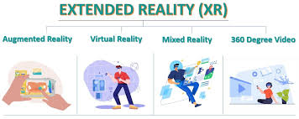
EXTENDED REALITY – IMMERSIVE TECHNOLOGIES
Extended Reality (XR) is an umbrella term that encompasses all immersive technologies, including augmented reality (AR), mixed reality (MR), and virtual reality (VR). It refers to any combination of real and virtual environments, where users interact with digital elements.
Augmented Reality (AR) overlays digital content (images, sounds, or information) onto the real world through devices like smartphones or AR glasses. Users remain aware of their physical environment while interacting with virtual objects.
Mixed Reality (MR) blends the real and virtual worlds more deeply than AR, allowing digital and physical objects to interact in real time. Users can manipulate both types of objects as if they coexist.

Slide 9
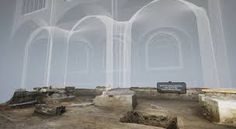
EXTENDED REALITY (ER) – IMMERSIVE TECHNOLOGIES
Virtual Reality (VR) immerses users in a fully digital, computer-generated environment, cutting them off from the real world. VR is experienced using devices like headsets, where users can explore and interact with the virtual world.
The key difference lies in the level of immersion and interaction with the real world, with VR being fully immersive, AR being an overlay on the real world, and MR allowing for a blend and interaction of both.
The full potential of emerging and immersive technologies has yet to be realized ▷ AI
EVEN MORE IMMERSIVE EXPERIENCES, COMPLETE WITH FEELINGS OF TEXTURE, THERMAL PROPERTIES, ACOUSTIC AND OLFACTORY INFORMATION SPECIFIC TO A TIME PERIOD OFFERS A MORE COMPLETE VIEW AND UNDERSTANDING OF CULTURAL HERITAGE

Slide 10
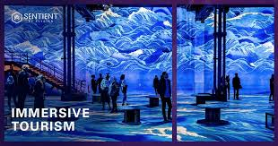
Metaverse and New Opportunities for Cultural Heritage sites:
Virtual Tourism and Accessibility
- Global access via immersive virtual experiences
- Interactive AR/VR experiences for deeper engagement
It can bring immersive experiences that enables users to explore historical sites, artifacts and cultural narratives in a virtual space. Through VR/AR users can engage with heritage in dynamic walys that traditional methods cannot offer, also with 360-degree views;
It can make heritage sites accessible to a global audience. Who cannot travel can explore and learn about different cultures and histories from their own homes;
Reducing physical travel , virtual tourism can contribute to sustainability actions, mitigating the carbon footprint associated with traditional tourism

Slide 11
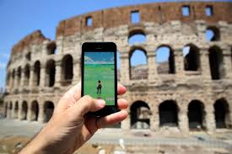
Metaverse and New Opportunities for Cultural Heritage sites:
2) Enhanced Storytelling and Education
- Immersive historical reenactments and interactive learning
- Gamification to make history engaging, especially for youth
Educational programs can be enhanced through interactive experiences in the metaverse, turning traditional learning into engaging activities that can captivate audience, in particular younger generations
Gamification may include:
Interactive challenges such as incorporate quizzes, puzzles and tasks that encourages visitors to explore facts and artifacts in a fun way;
Quests and Adventures: create story-driven quests or virtual treasure hunts that guide users through different eras or events, making history exploration more dinamic

Slide 12
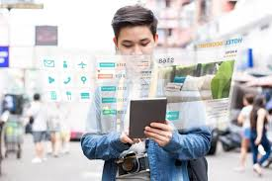
Metaverse and New Opportunities for Cultural Heritage sites:
2) Enhanced Storytelling and Education
- Immersive historical reenactments and interactive learning
- Gamification to make history engaging, especially for youth
III) Rewards and Achievements: Offer virtual rewards or badges for completing activities, motivating users to engage with more historical content;
IV) Multiplier Experiences: Enable groups to collaborate or compete in challenges related to historical events, fostering learning through social interaction;
V) Educational Games: Develop games where players role-play as historical figures or civilizations, experiencing decisions and events from a first-person perspective

Slide 13
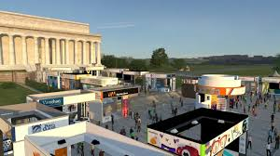
Metaverse and New Opportunities for Cultural Heritage sites:
3) Preservation and Digital Twin Technology
- Digital twins for preserving endangered sites
- Virtual archiving of data and artifacts for research and public access
The metaverse can host digital twins of physical sites, enabling their promotion and education, while safeguarding physical degradation or endangered sites
Digital documentation and representation of heritage sites can aid in their preservation
Local «heritage communities» can use the metaverse to share their cultural stories, customs and practices in a innovative way, in the perspective of preserving them for future generations

Slide 14
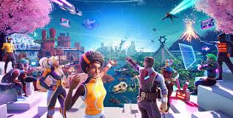
Metaverse and New Opportunities for Cultural Heritage sites:
4) Community Building and Social Engagement
- Collaborative virtual espaces for global cultural exchange
- Virtual heritage sites fostering cross-cultural appreciation
Virtual environments can foster community engagement and interaction among users ▷ enabling conditions of collaborative projects, discussions and shared learning experiences that convey diverse perspectives to heritage matters
Virtual sites enables users worldwide to explore heritage sites from different regions, promoting understanding of diverse histories and traditions, fostering cultural dialogue and exchange, fostering respect and appreciation in a wider context of fostering a sense of global community

Slide 15
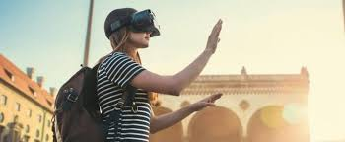
Metaverse and New Opportunities for Cultural Heritage sites:
5) New Revenue Streams
- Virtual ticket sales for esclusive tours and content
- NFTs (Non-Fungible Tokens) and digital artifacts as new fundraising avenues
Activation of exclusive virtual tours such as expert-led virtual tours of heritage sites that are not available to the general public, live-streamed talks, workshops, live events. They can be also early or exclusive access to new digital exhibits or reconstruction of historical sites, as well as personalizex content tailored virtual experiences.
Create and sell limited edition NFTs representing virtual replicas of historical artifacts from heritage sites ▷ fundraising for sites preservation , restauration projects or educational programs.

Slide 16
Metaverse and New Opportunities for Cultural Heritage sites:
6) Augmented Real-World Experiences
- AR apps enhancing visits to physical heritage sites
- Hybrid experiences blending physical and virtual events.
A) AR can overlay historical reconstructions onto present-day ruins, with an immersion of the visitor to the original look of the cultural site, layered information pointing the device towards landmarks to access to multimedia content or 3D Models, time travel, experiencing different historical periods of the same site, enriching the understanding of its evolution.

Slide 17
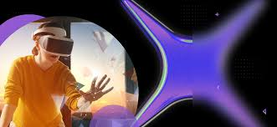
Challenges of Metaverse for Cultural Heritage sites:
Digital Equity: ensuring equal access for everyone to the technologies needed to experience the metaverse is pivotal to prevent widening the gap between different social groups;
Authenticity and Representation: it is crucial that cultural representations are accurate and respectful, involving local communities in the development of virtualexperiences to avoid misrepresentation, herewith the relevance of the role of heritage professionals abd the collaboration with them
Sustainability: the environmental impact of virtual platforms must be assessed alonside economics and resource allocation for creating immersive experiences, taking into account that it may require significant investment and resources. Quick obsolescence of Extended Reality (EX) technologies.

Slide 18
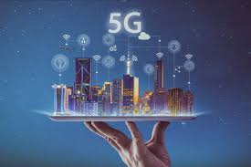
Smart Tourism perspective with Metaverse
Smart Tourism Ecosystem in the framework of the interchange of the real with digital world:
Internet of things
Fifth Generation Mobile Phone Network (5G)
Radio Frequency Identification (RDIF)
Near Field Communication (NFC)
Key components of tourism that may be enhanced with redefinition of intelligent packing with AR features with possible perspectives of personalized and multisensorial attributes
- Tourism attractions, accommodation, food & catering and transportation

Slide 19
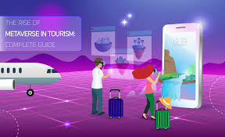
Smart Tourism perspective with Metaverse
Metaverse creates an opportunity for technology-enhanced and reinforced tourist experiences in a eco-system of new technology driven services:
Demand for a deeper cultural experience
Learning
Self-actualization in society
Ethical and sustainable tourism
Alternative destinations that do not exist exist in the physical world wihich enables immersive and embodied experiences, creates new self-made egos (avatars)

Slide 20
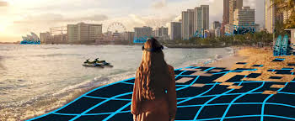
Conclusive reflections on Metavese and cultural tourism
Metaverse has the technological potential to create new tourist experiences that goes beyond the traditional understanding of time and space and erase the border between virtual and reak tourist experience
Metaverse may become an integral component of the tourism ecosystem with so far unknown virtual possibilities to experience people, objects, attractions, time travel, historical legacy and storytelling of a specific cultural site, viceversa, tourism might become a niche product within the metaverse ecosystem, herewith the challenge to make it inclusive and eccessible to the widest audience possible of visitors
Metaverse as disruptive technology may redifine tourism in a broader phenomenon of «a social, cultural and economic phenomenon that entails the transit of people or their digital twins to real or virtual places outside their usual environment for personal or business/professional purposes»

Slide 21
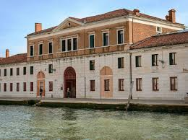
Ca’ Foscari University of Venice
Department of Economics
Daniele Sferra – project manager FORTIC project / Vice President EFFORTS
Cannaregio 873 . 30121 Venice - Italy
daniele.sferra@unive.it
+39 3316920577
www.unive.it

