Slide 1
Networking and cooperation: The value and future of cultural networks
Project FORTIC conference & EFFORTS Annual Congress: “Sustainable business models for fortifications”
St. John’s Fortress Campus, ŠIBENIK
October 24th -25th 2024

Slide 2
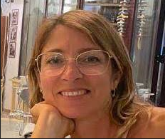
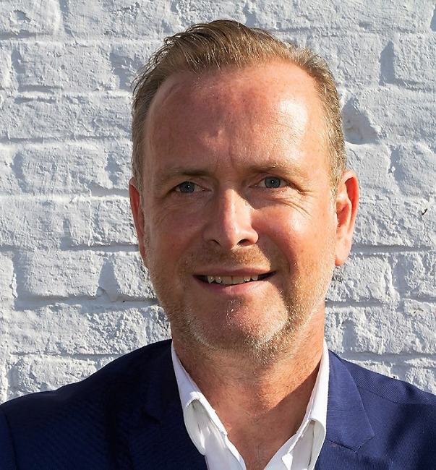
Presenters : Simona Melchiorri – Rafaël Deroo
*City of Cervia (IT), member of European Cultural Route ‘ATRIUM’
*EFFORTS Europe secretary general

Slide 3
The goal of the topic is to come to a fruitful discussion on the following elements :
-European networks, what are they and why are they there? For what reasons should one join a heritage network in Europe ? How can networking be optimalised ? What are best practices for European networking ? What are its objectives ?
-What does a heritage network do ? Are there other ways of European cooperation ? Who should initiate a network ? How should they be funded?
- Is networking a value ?
- Insights and inspiration for efficient European networking for fortified sites stakeholders.

Slide 4
Our approach in a 2 hours discussion on European heritage networks
First 4 Statements (1-4) in different parts of the : participants put post-its. Each addresses pro / con ARGUMENTATION or ANSWERS for each statement on a post-it (10 min)
Penary discussion on each statement’s pros an cons and come up with position per statement (10 min)
Short break (5 min)
Second 4 Statements (5-8) (10 min)
Discussion (10 min)
Wrap-up of the positions (5 min)

Slide 5
First 4 Statements (1-4)
What is a network ?
All networks are the same
3. There is no need for networking
4. Networks should be set up ‘bottom-up’

Slide 6
Second 4 Statements (5-8)
5. The best networks are on local issues
6. What should a network do / provide ?
7. Networks should not receive funding
8. A network should work by values

Slide 7
CONTACT :
Simona Melchiorri, EU funds and cooperation project manager, City of Cervia (IT)
Rafaël Deroo, Secretary general of EFFORTS Europe
melchiorris@comunecervia.it
www.communecervia.it
rafael.deroo@efforts-europe.eu
www.efforts-europe.eu

